Slide 1

C# Fundamentals

Slide 2
Learning Objectives
Introduction to C#
Understand the role of variables in C#.
C# Basics: Syntax and Structure
Learn about different data types and their usage.
Gain proficiency in using operators for various operations.
Basics of Unity Scripting in C#

Slide 3
Why C# for Unity?
C#: The Preferred Language for Unity Development
C# is the most widely used and recommended language for Unity game development. Here's why:
Strong Community and Support: A vast community of C# developers and extensive resources are available to help you.
Industry Standard: C# is a versatile language used in various industries, including web development and software engineering.
Interoperability with .NET: Leverage the power of the .NET framework for advanced features.
Ease of Learning: C# is relatively easy to learn, especially for those with programming experience.

Slide 4
The Benefits of C# in Unity
C# Offers Several Advantages:
Performance: C# offers excellent performance and optimization capabilities.
Object-Oriented Programming: C# is a strongly object-oriented language, making it ideal for game development.
Advanced Features: C# supports advanced features like generics, LINQ, and asynchronous programming.
Unity Integration: C# is tightly integrated with the Unity engine, providing seamless access to its features and APIs.

Slide 5
Understanding the Features of C#
C# is a powerful and versatile programming language with several key features that make it well-suited for game development with Unity:
Compiled Language: Ensures efficient execution and performance optimization.
Managed Code: Benefits from automatic memory management, reducing the risk of memory leaks.
Strongly Typed: Enforces type safety, leading to more reliable and maintainable code.
Function-Based: Allows for modular and reusable code through functions and methods.
Object-Oriented: Supports object-oriented programming principles, enabling code organization and reusability.

Slide 6
C# Is a Compiled Language
A compiled language is a programming language where the source code is translated into machine code, which is directly understood by the computer's processor. This process, called compilation, happens before the program is executed.

Slide 7
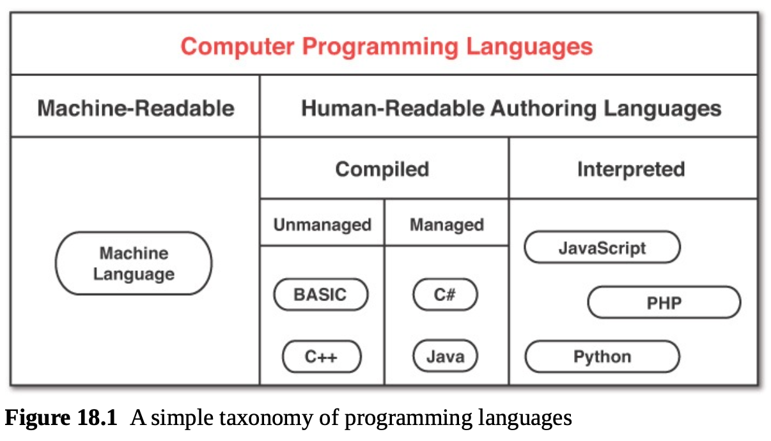
C# Is a Compiled Language (cont.)
Benefits of compiled languages:
Faster execution: Compiled code runs directly on the hardware, leading to faster performance.
Better optimization: Compilers can optimize the code for specific hardware, resulting in efficient execution.
Example of compiled languages: C, C++, C#, and Java.

Slide 8
C# Is Managed Code
Managed code is a type of code that is executed under the control of a runtime environment, such as the Common Language Runtime (CLR) in the .NET framework. This runtime environment handles many low-level details, including memory management, automatically.

Slide 9
C# Is Managed Code (cont.)
Key benefits of managed code:
Automatic Memory Management: The runtime automatically allocates and deallocates memory for objects, reducing the risk of memory leaks and other common programming errors.
Type Safety: The runtime ensures that variables are used correctly, preventing type-related errors.
Security: The runtime provides security features like code access security, which helps protect applications from malicious code.
Cross-Platform Compatibility: Managed code can be compiled into an intermediate language (IL) that can be executed on different platforms with the appropriate runtime environment.
In essence, managed code simplifies development by handling many complex tasks behind the scenes, allowing developers to focus on writing the core logic of their applications.

Slide 10
C# Is Strongly Typed
C# is a strongly typed language, meaning that each variable must be declared with a specific data type. This ensures type safety and allows the compiler to perform type checking, leading to more reliable and efficient code.

Slide 11
C# Is Strongly Typed (cont.)
Benefits of Strong Typing:
Early Error Detection: The compiler can identify type mismatches during compilation, preventing runtime errors.
Improved Code Readability: Explicit data types enhance code clarity and maintainability.
Optimized Performance: The compiler can generate more efficient code by knowing the exact data types at compile time.
Enhanced Code Completion: IDEs can provide accurate code suggestions based on type information.

Slide 12
C#: A Function-Based Language (cont.)
C# is a function-based language, allowing you to break down complex tasks into smaller, reusable functions.
Key Benefits of Function-Based Programming:
Modularity: Functions encapsulate specific tasks, making code more organized and easier to understand.
Reusability: Functions can be reused in different parts of your program or even in other projects.
Improved Readability: Breaking down complex logic into smaller functions enhances code clarity.
Efficient Development: By reusing existing functions, you can save time and effort.

Slide 13
C#: An Object-Oriented Language
C# is a powerful object-oriented programming language, allowing you to model real-world entities as objects.
Key concepts of object-oriented programming in C#:
Classes: Blueprints for creating objects.
Objects: Instances of classes, representing real-world entities.
Inheritance: Creating new classes based on existing ones, inheriting properties and methods.
Polymorphism: The ability of objects to take on many forms.
Encapsulation: Grouping data and methods within a class, hiding implementation details.
By understanding and applying these object-oriented principles, you can create well-structured, maintainable, and reusable code in C#.

Slide 14
C#: An Object-Oriented Language (cont.)
Benefits of Strong Typing:
Early Error Detection: The compiler can identify type mismatches during compilation, preventing runtime errors.
Improved Code Readability: Explicit data types enhance code clarity and maintainability.
Optimized Performance: The compiler can generate more efficient code by knowing the exact data types at compile time.
Enhanced Code Completion: IDEs can provide accurate code suggestions based on type information.

Slide 15
2.1 C# Scripting in Unity

Slide 16
C# Scripting in Unity
C# is the primary scripting language used in Unity. It allows you to create custom scripts to define the behavior of GameObjects in your scene.
Key Uses of C# Scripts:
Creating Game Logic: Implement game rules, scoring systems, and AI behaviors.
Interacting with GameObjects: Manipulate GameObjects, their components, and their properties.
Responding to User Input: Handle player input and trigger game events.
Creating Custom Components: Extend Unity's functionality with custom components.
References: https://docs.unity3d.com/2022.3/Documentation/Manual/CreatingAndUsingScripts.html

Slide 17
Getting Started with C# Scripting
To start scripting in Unity:
Create a New C# Script: Right-click in the Project window and select "Create > C# Script."
Write Your Script: Use C# syntax to define classes and methods that control GameObject behavior.
Attach the Script to a GameObject: Drag and drop the script onto a GameObject in the Hierarchy.
Write Code: Use C# to implement game logic, interact with Unity's API, and create custom behaviors
References: https://docs.unity3d.com/2022.3/Documentation/Manual/CreatingAndUsingScripts.html

Slide 18
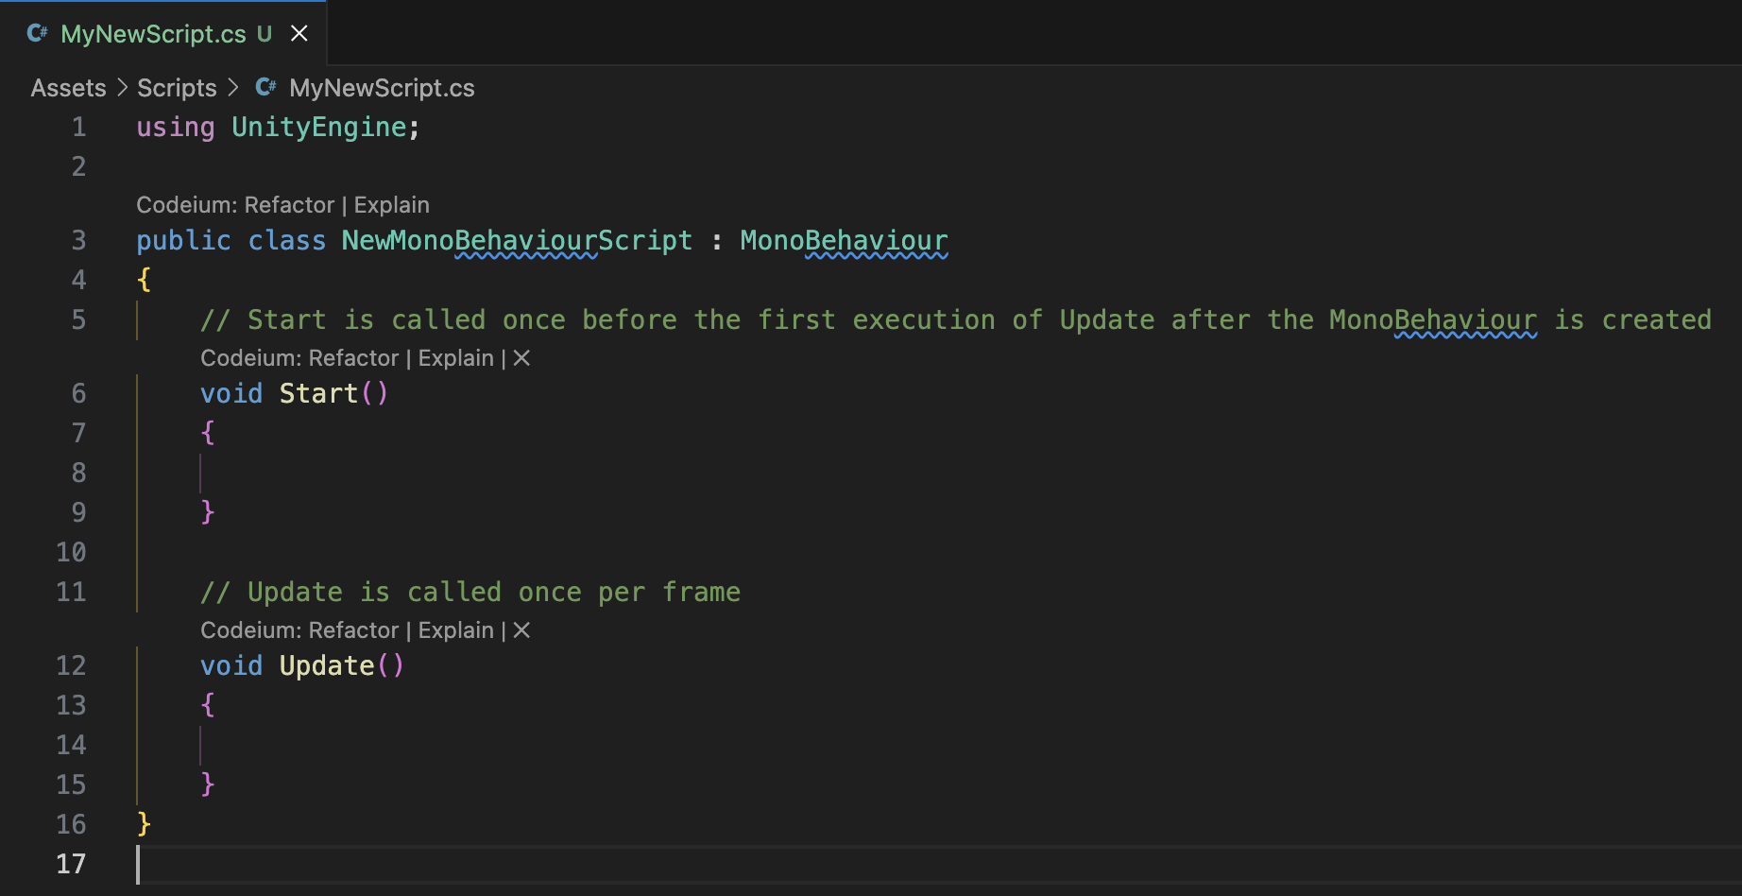
Getting Started with C# Scripting (cont.)

Slide 19
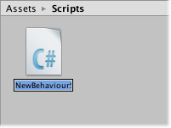
Practice - Your first C# script in Unity.
Creating Scripts
A new script can be created from the Create menu at the top left of the Project panel or by selecting Assets > Create > C# Script from the main menu.
The new script will be created in whichever folder selected in the Project panel. The new script file’s name will be selected, prompting user to enter a new name.
References: https://docs.unity3d.com/2022.3/Documentation/Manual/CreatingAndUsingScripts.html

Slide 20
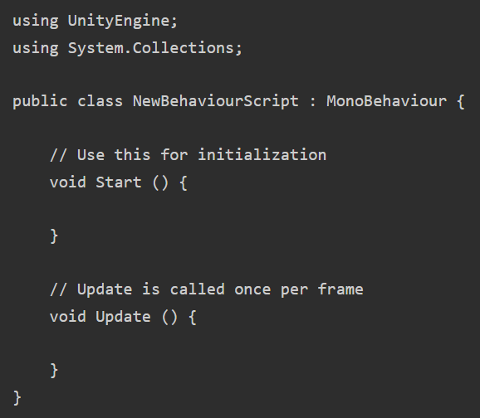
Practice - Your first C# script in Unity.
Anatomy of a Script file
When double-click a script Asset in Unity, it will be opened in a text editor. By default, Unity will use Visual Studio, but user can select any editor you like from the External Tools panel in Unity’s preferences (go to Unity > Preferences).
The initial contents of the file will look something like this:
References: https://docs.unity3d.com/2022.3/Documentation/Manual/CreatingAndUsingScripts.html

Slide 21

Practice - Your first C# script in Unity.
Controlling a GameObject
In Unity, a script serves as a blueprint for a Component, with its code activating only when attached to a GameObject. Attachment can be done by dragging the script asset to a GameObject in the hierarchy panel or the selected GameObject's inspector.
The Component menu's Scripts submenu displays all available scripts, including user-created ones. The script instance looks much like any other Component in the Inspector:
References: https://docs.unity3d.com/2022.3/Documentation/Manual/CreatingAndUsingScripts.html

Slide 22
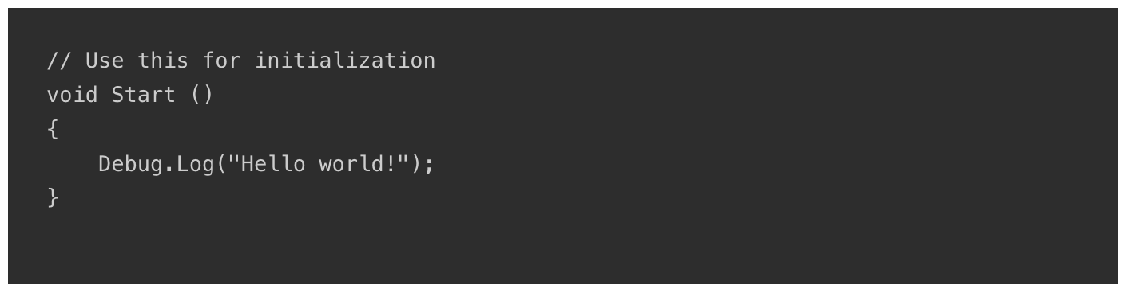
Practice - Your first C# script in Unity.
Controlling a GameObject
Once attached, the script will start working when user press Play and run the game. It can be checked by adding the following code in the Start function:
Debug.Log is a simple command that just prints a message to Unity’s console output. If Play is pressed, the message should appear at the bottom of the main Unity editor window and in the Console window (menu: Window > General > Console)
References: https://docs.unity3d.com/2022.3/Documentation/Manual/CreatingAndUsingScripts.html

Slide 23
2.2 Variables, data types, operators

Slide 24
Variables in C#
Think of a variable as a container that holds a specific type of data. Just like a box can hold books, toys, or clothes, a variable can hold numbers, text, or other types of information. When you declare a variable, you're essentially creating this container and giving it a name. The data type tells the computer what kind of data the variable can hold.
A named location in memory to store data.
Declared with a specific data type (e.g., int, float, string).
Can be assigned a value at declaration or later.

Slide 25
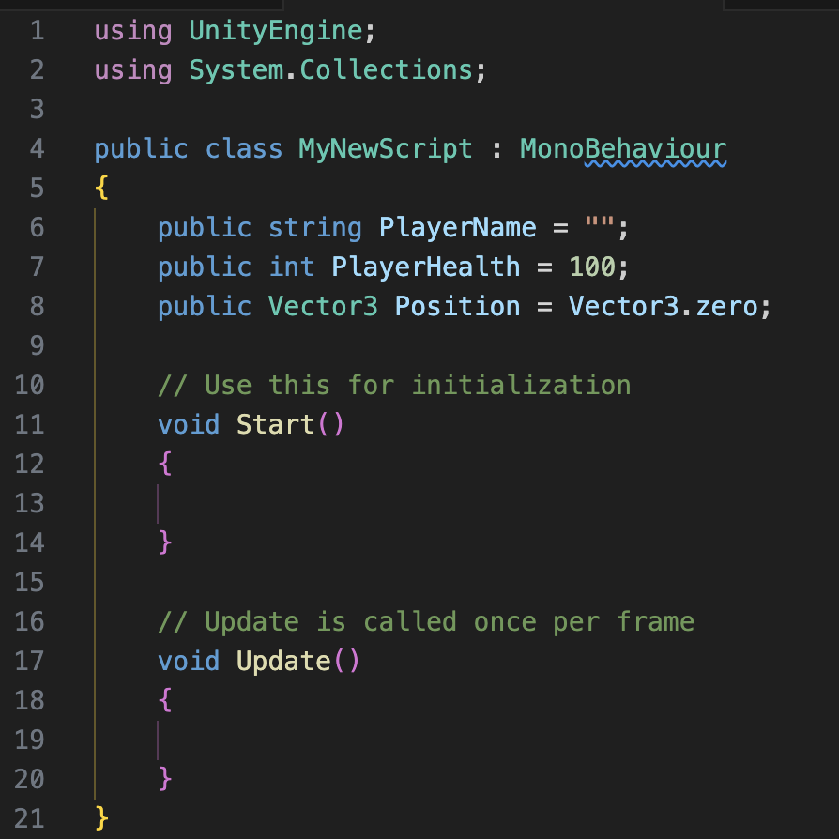
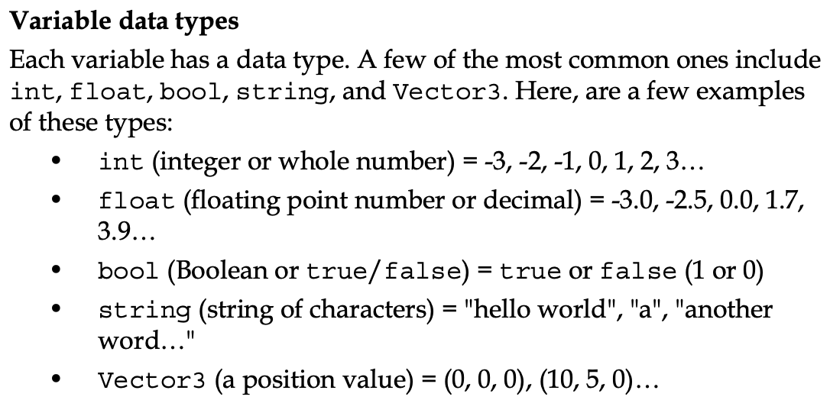
Variables in C#

Slide 26
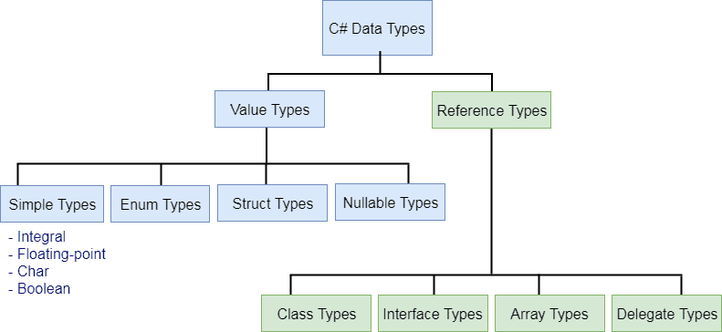
C# data types
Notes:
Refer

Slide 27
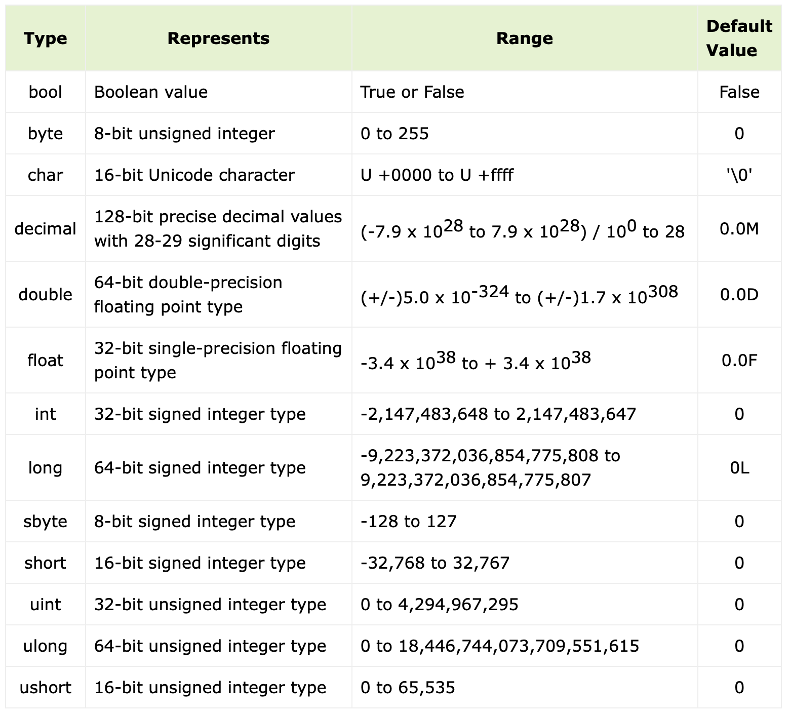
C# data types

Slide 28
C# data types
Numbers in C#
In C#, numbers are categorized into two primary types:
Integer Types:
Represent whole numbers without decimal points.
Examples: int, short, long, byte, sbyte, ushort, uint, ulong
Floating-Point Types:
Represent numbers with decimal points.
Examples: float, double, decimal

Slide 29
C# data types
Numbers in C#

Slide 30
C# data types
Numbers in C# - INT
The int data type is 32-bit signed integer. It can store numbers from -2,147,483,648 to 2,147,483,647. The int keyword is an alias of Int32 struct in .NET.
Integer Types:
int: A 32-bit signed integer that can store numbers from -2,147,483,648 to 2,147,483,647.
uint: A 32-bit unsigned integer that can store positive numbers from 0 to 4,294,967,295.

Slide 31
C# data types
Numbers in C# - INT
The int data type is 32-bit signed integer. It can store numbers from -2,147,483,648 to 2,147,483,647. The int keyword is an alias of Int32 struct in .NET.
Integer Types:
int: A 32-bit signed integer that can store numbers from -2,147,483,648 to 2,147,483,647.
uint: A 32-bit unsigned integer that can store positive numbers from 0 to 4,294,967,295.

Slide 32
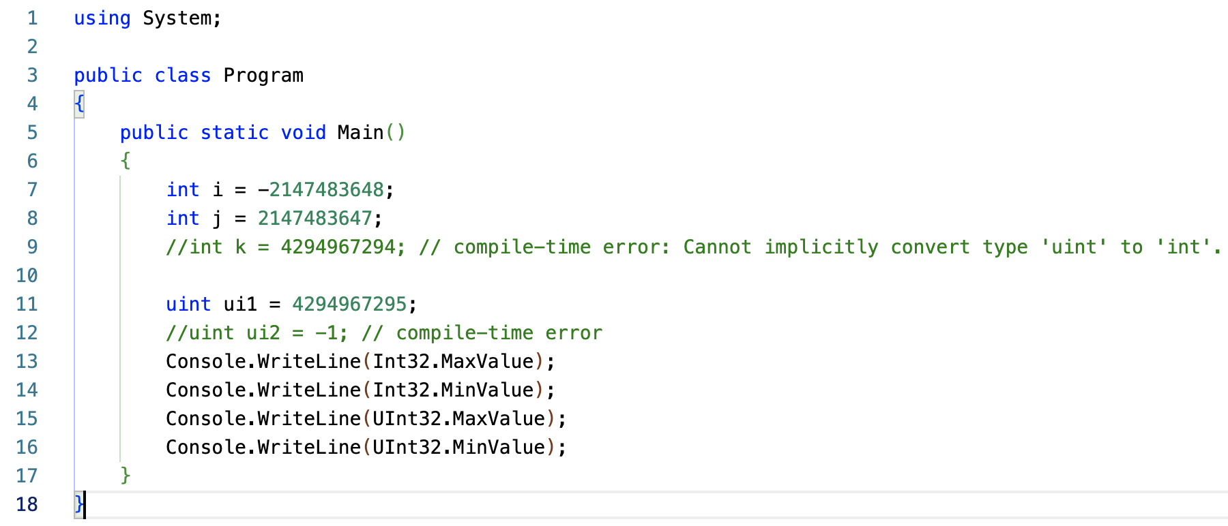
C# data types
Numbers in C# - INT

Slide 33
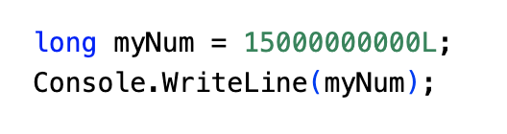
C# data types
Numbers in C# - LONG
The long data type can store whole numbers from -9223372036854775808 to 9223372036854775807. This is used when int is not large enough to store the value. Note that you should end the value with an "L":

Slide 34
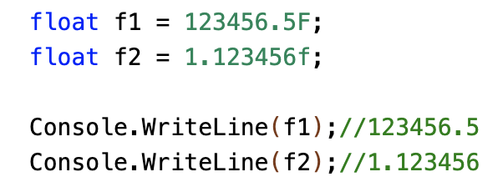
C# data types
Numbers in C# - FLOAT
The float data type is used to represent single-precision floating-point numbers. It can store a wide range of values, including both very small and very large numbers. However, it has limitations in terms of precision, especially for extremely large or small numbers.

Slide 35
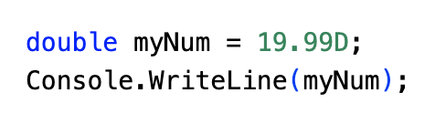
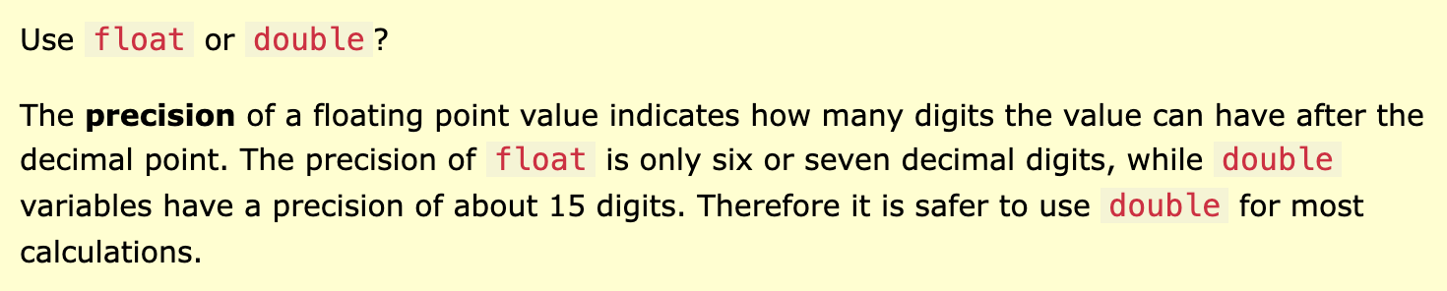
C# data types
Numbers in C# - DOUBLE
The float and double data types can store fractional numbers. Note that you should end the value with an "F" for floats and "D" for doubles:

Slide 36
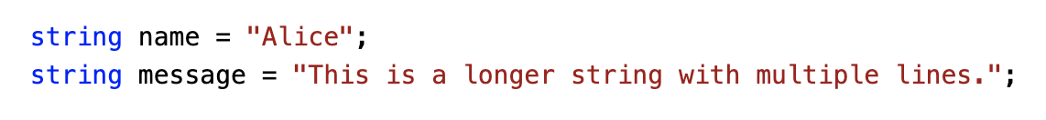
C# data types
C# Strings
In C#, strings are used to represent textual data. They are enclosed within double quotes ("").
Key points:
String data type: Used to store sequences of characters.
Maximum length: Theoretically, a string can hold up to 2 billion characters, but practical limitations may apply.

Slide 37
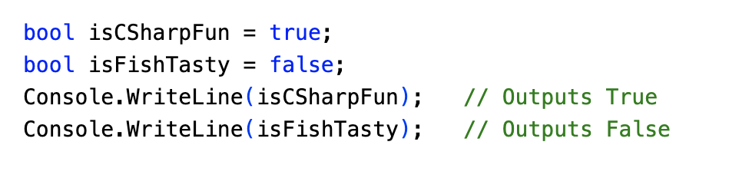
C# data types
C# - Booleans
A boolean data type is declared with the bool keyword and can only take the values true or false:

Slide 38
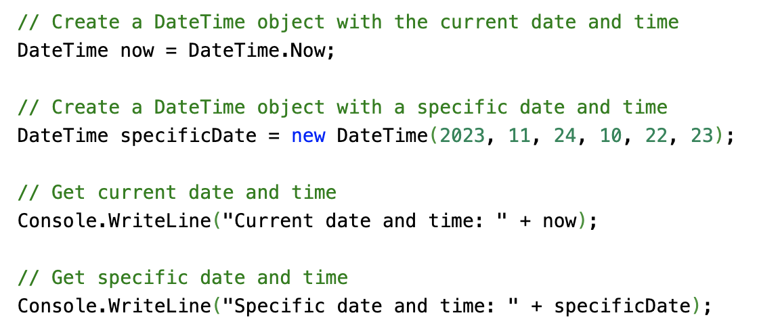
C# data types
Date and Time in C#

Slide 39
C# data types
C# - Struct
A struct is a value type in C# used to define a data structure. It's a lightweight alternative to classes, often used for simple data containers.
Key Characteristics of Structs:
Value Type: Structs are passed by value, meaning a copy of the struct is created when it's passed to a method or assigned to a new variable.
Default Constructor: Structs don't have a default parameterless constructor. You must provide values for all fields during initialization.
No Inheritance: Structs cannot inherit from other structs or classes.
No Virtual Methods: Structs cannot contain virtual or abstract methods.
Performance: Structs are generally more performant than classes, especially for small data structures.

Slide 40
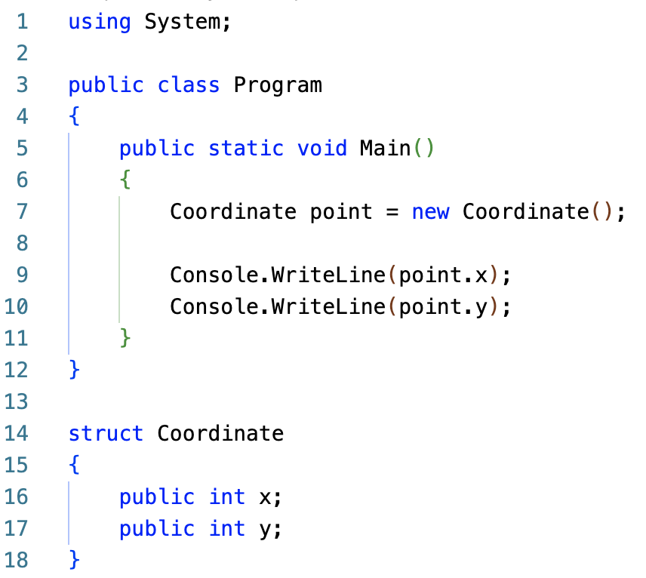
C# data types
C# - Struct
When to Use a Struct:
Small Data Structures: For simple data structures with a few fields.
Immutable Data: When you want to create immutable objects.
Performance-Critical Scenarios: In performance-critical scenarios where value type semantics are beneficial.

Slide 41
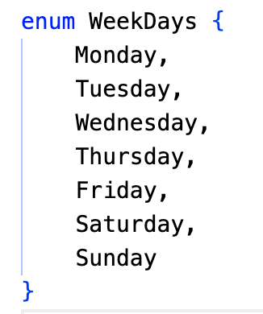
C# data types
Enum in C#
In C#, an enum (or enumeration type) is used to assign constant names to a group of numeric integer values. It makes constant values more readable, for example, WeekDays.Monday is more readable then number 0 when referring to the day in a week.

Slide 42
C# data types
Enum in C#
In C#, an enum (or enumeration type) is used to assign constant names to a group of numeric integer values. It makes constant values more readable, for example, WeekDays.Monday is more readable then number 0 when referring to the day in a week.
Key points:
A set of named constants representing a group of related values.
Simplifies code readability and maintainability.
Used to define a specific set of possible values for a variable.

Slide 43
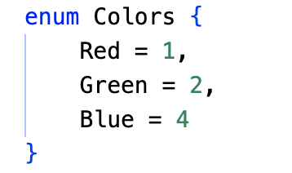
C# data types
Enum in C#
Assigning Values:
Default Values: If not specified, values start from 0 and increment by 1.
Custom Values: You can assign specific values to enum members.

Slide 44
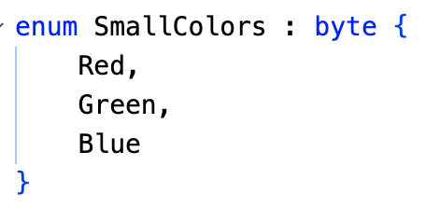
C# data types
Enum in C#
Assigning Values:
Default Values: If not specified, values start from 0 and increment by 1.
Custom Values: You can assign specific values to enum members.
Underlying Type:
Enums can be based on different integer types (byte, short, int, long, etc.).
The default underlying type is int.
You can specify the underlying type explicitly:

Slide 45
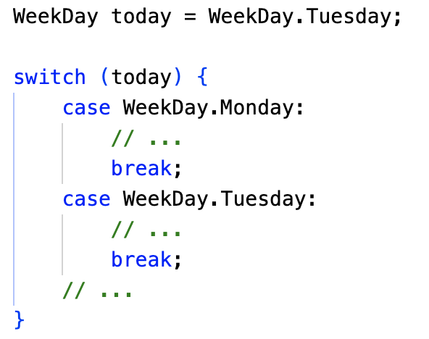
C# data types
Enum in C#
Accessing Enum Members:
Use the dot notation to access specific enum members.
Example: WeekDays.Monday
Converting Enums to Integers:
Cast the enum value to an integer: int dayNumber = (int)WeekDays.Wednesday;
Using Enums in Switch Statements:

Slide 46
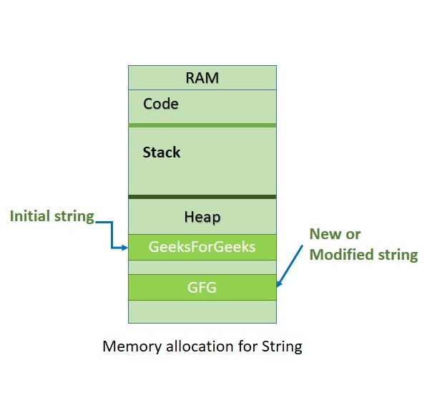
C# data types
C# - Immutable String
In C#, strings are immutable, meaning they cannot be changed once created. When you modify a string, a new string object is created in memory. This can be inefficient for frequent modifications, as it involves creating and discarding multiple string objects. strings.

Slide 47
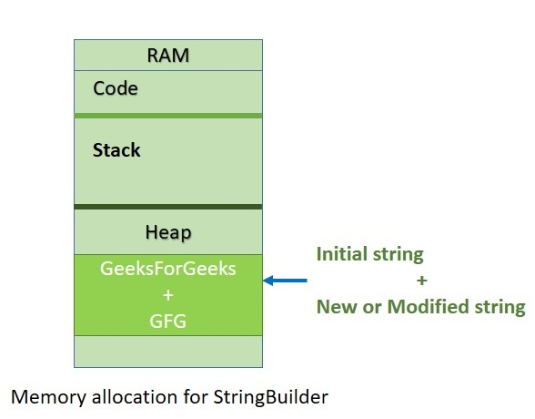
C# data types
C# - StringBuilder
Solution: Using StringBuilder
To improve performance when working with strings that undergo frequent modifications, use the StringBuilder class. StringBuilder is a mutable class that allows you to efficiently build and manipulate strings.

Slide 48
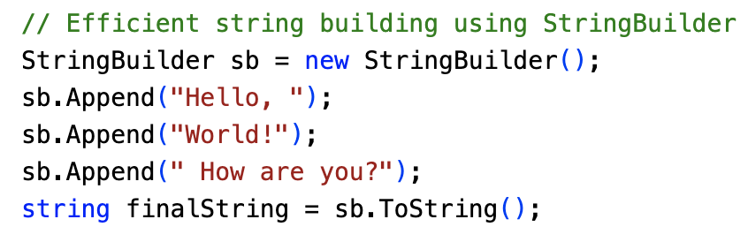
C# data types
C# - StringBuilder Example
Points to Remember :
StringBuilder is mutable.
StringBuilder performs faster than string when appending multiple string values.
Use StringBuilder when you need to append more than three or four strings.
Use the Append() method to add or append strings to the StringBuilder object.
Use the ToString() method to retrieve a string from the StringBuilder object.

Slide 49
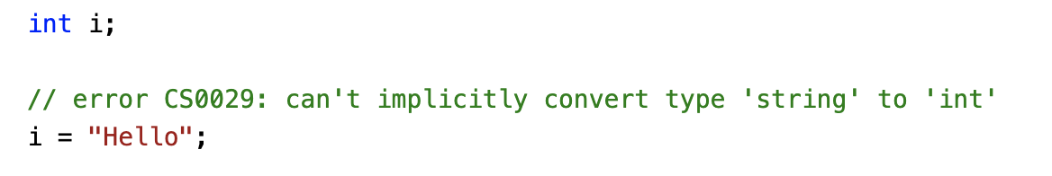
Casting and type conversions
Type casting is when you assign a value of one data type to another type.
In C#, there are two types of casting:
Implicit Casting (automatically) - converting a smaller type to a larger type size char -> int -> long -> float -> double
Explicit Casting (manually) - converting a larger type to a smaller size type double -> float -> long -> int -> char
References: https://learn.microsoft.com/en-us/dotnet/csharp/programming-guide/types/casting-and-type-conversions

Slide 50
Casting and type conversions
Implicit conversions: No special syntax is required because the conversion always succeeds and no data is lost. Examples include conversions from smaller to larger integral types, and conversions from derived classes to base classes.
Explicit conversions (casts): Explicit conversions require a cast expression. Casting is required when information might be lost in the conversion, or when the conversion might not succeed for other reasons. Typical examples include numeric conversion to a type that has less precision or a smaller range, and conversion of a base-class instance to a derived class
References: https://learn.microsoft.com/en-us/dotnet/csharp/programming-guide/types/casting-and-type-conversions

Slide 51
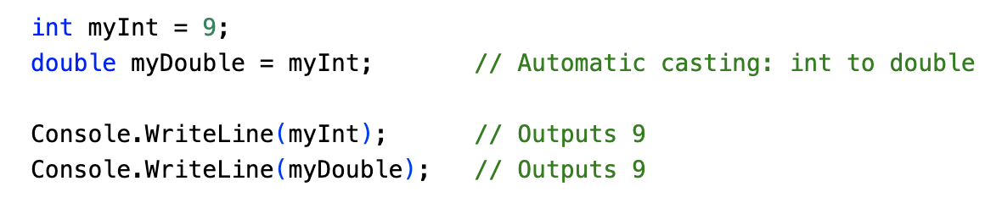
Casting and type conversions
Implicit Conversions
Implicit casting is done automatically when passing a smaller size type to a larger size type:
References: https://learn.microsoft.com/en-us/dotnet/csharp/programming-guide/types/casting-and-type-conversions

Slide 52
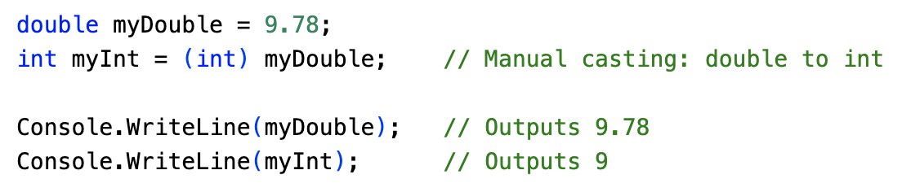
Casting and type conversions
Explicit Casting
Explicit casting must be done manually by placing the type in parentheses in front of the value:
References: https://learn.microsoft.com/en-us/dotnet/csharp/programming-guide/types/casting-and-type-conversions

Slide 53
Casting and type conversions
User-defined conversions: User-defined conversions use special methods that you can define to enable explicit and implicit conversions between custom types that don't have a base class–derived class relationship. For more information, see User-defined conversion operators.
Conversions with helper classes: To convert between non-compatible types, such as integers and System.DateTime objects, or hexadecimal strings and byte arrays, you can use the System.BitConverter class, the System.Convert class, and the Parse methods of the built-in numeric types, such as Int32.Parse. For more information, see How to convert a byte array to an int, How to convert a string to a number, and How to convert between hexadecimal strings and numeric types.
References: https://learn.microsoft.com/en-us/dotnet/csharp/programming-guide/types/casting-and-type-conversions

Slide 54
C# - Operators
What is an Operator?
A symbol that tells the compiler to perform a specific operation.
C# provides a rich set of operators for various operations.
Types of Operators:
Arithmetic Operators: Perform mathematical operations.
Relational Operators: Compare values.
Logical Operators: Perform logical operations (AND, OR, NOT).
Bitwise Operators: Manipulate bits within integers.
Assignment Operators: Assign values to variables.
Miscellaneous Operators: Other operators like increment, decrement, and conditional operators.

Slide 55
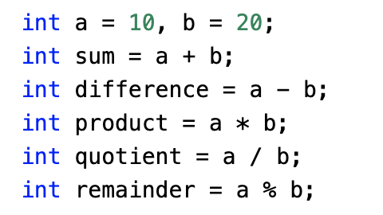
C# - Operators
Arithmetic Operators
+ (Addition)
- (Subtraction)
* (Multiplication)
/ (Division)
% (Modulo)
Further reading: https://learn.microsoft.com/en-us/dotnet/csharp/language-reference/operators/

Slide 56
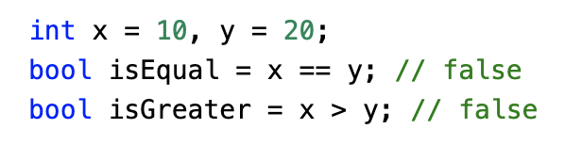
C# - Operators
Relational Operators
== (Equal to)
!= (Not equal to)
> (Greater than)
< (Less than)
>= (Greater than or equal to)
<= (Less than or equal to)
Further reading: https://learn.microsoft.com/en-us/dotnet/csharp/language-reference/operators/

Slide 57
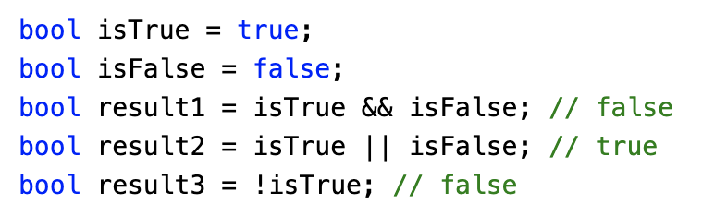
C# - Operators
Logical Operators
&& (Logical AND)
|| (Logical OR)
! (Logical NOT)
Further reading: https://learn.microsoft.com/en-us/dotnet/csharp/language-reference/operators/

Slide 58

C# - Operators
Operator Precedence in C#
Operator precedence determines the order in which operations are performed in an expression. Operators with higher precedence are ¹ evaluated first.
In this expression, the multiplication (*) operator has higher precedence than the addition (+) operator. So, the multiplication is performed first:
3 * 2 = 6
7 + 6 = 13
Therefore, the value of x is 13.
Further reading: https://learn.microsoft.com/en-us/dotnet/csharp/language-reference/operators/

Slide 59
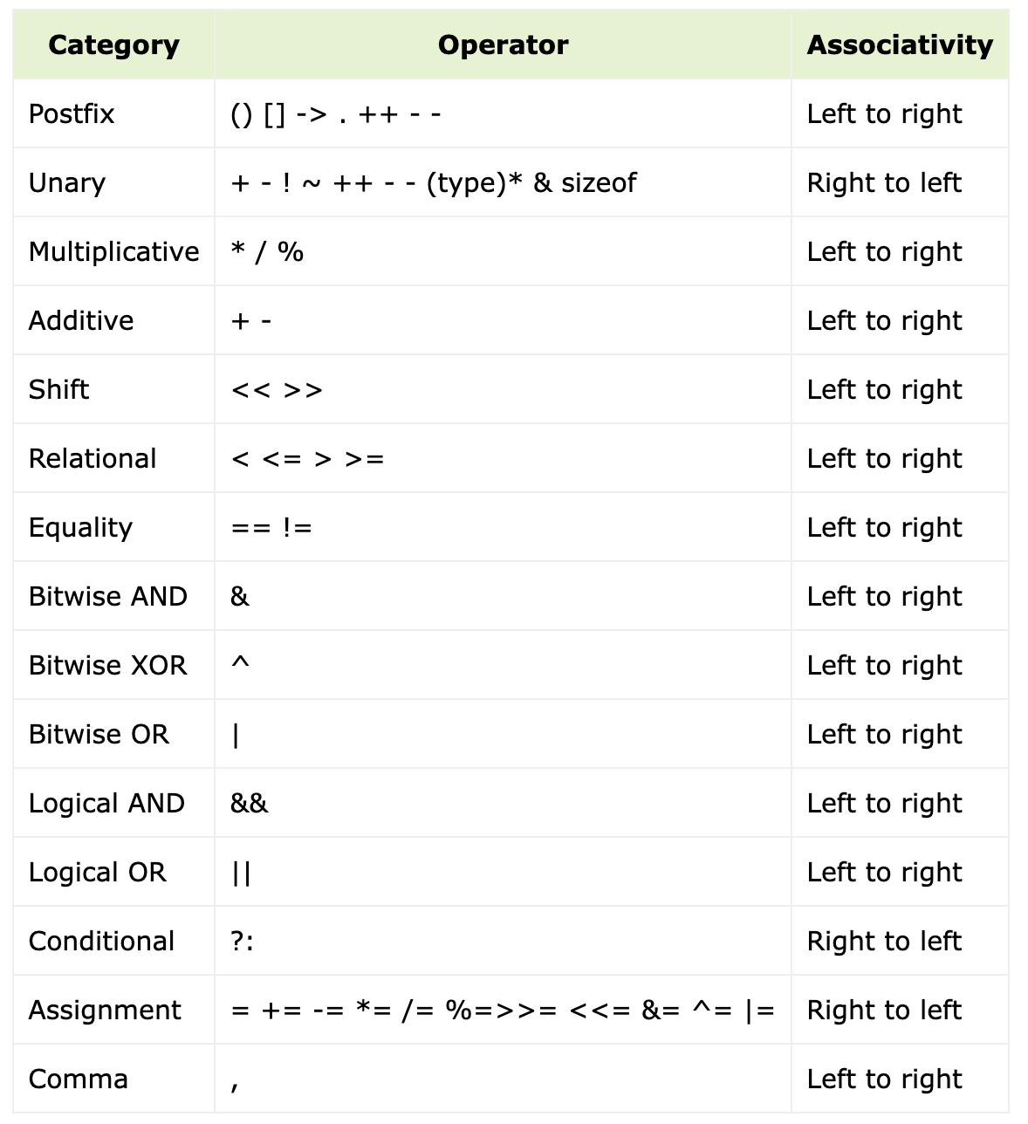
C# - Operators
Operator Precedence Table (Highest to Lowest)
Further reading: https://learn.microsoft.com/en-us/dotnet/csharp/language-reference/operators/

Slide 60
2.3 Selection statements
if, if-else, and switch
References: https://learn.microsoft.com/en-us/dotnet/csharp/language-reference/statements/selection-statements

Slide 61
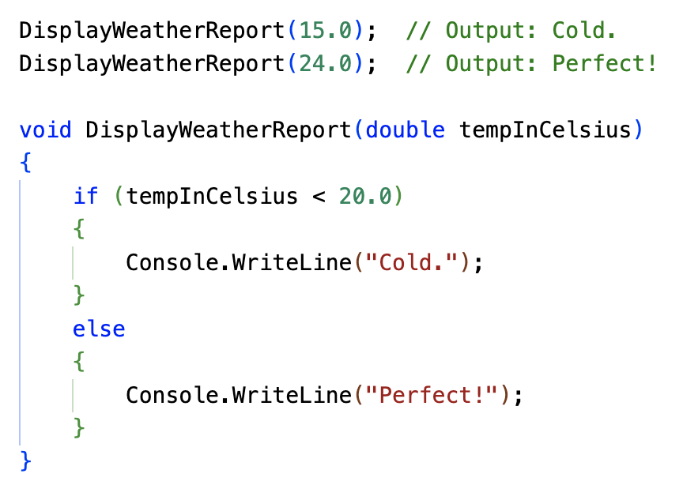
The if statement
An if statement with an else part selects one of the two statements to execute based on the value of a Boolean expression, as the following example shows:
References: https://learn.microsoft.com/en-us/dotnet/csharp/language-reference/statements/selection-statements

Slide 62
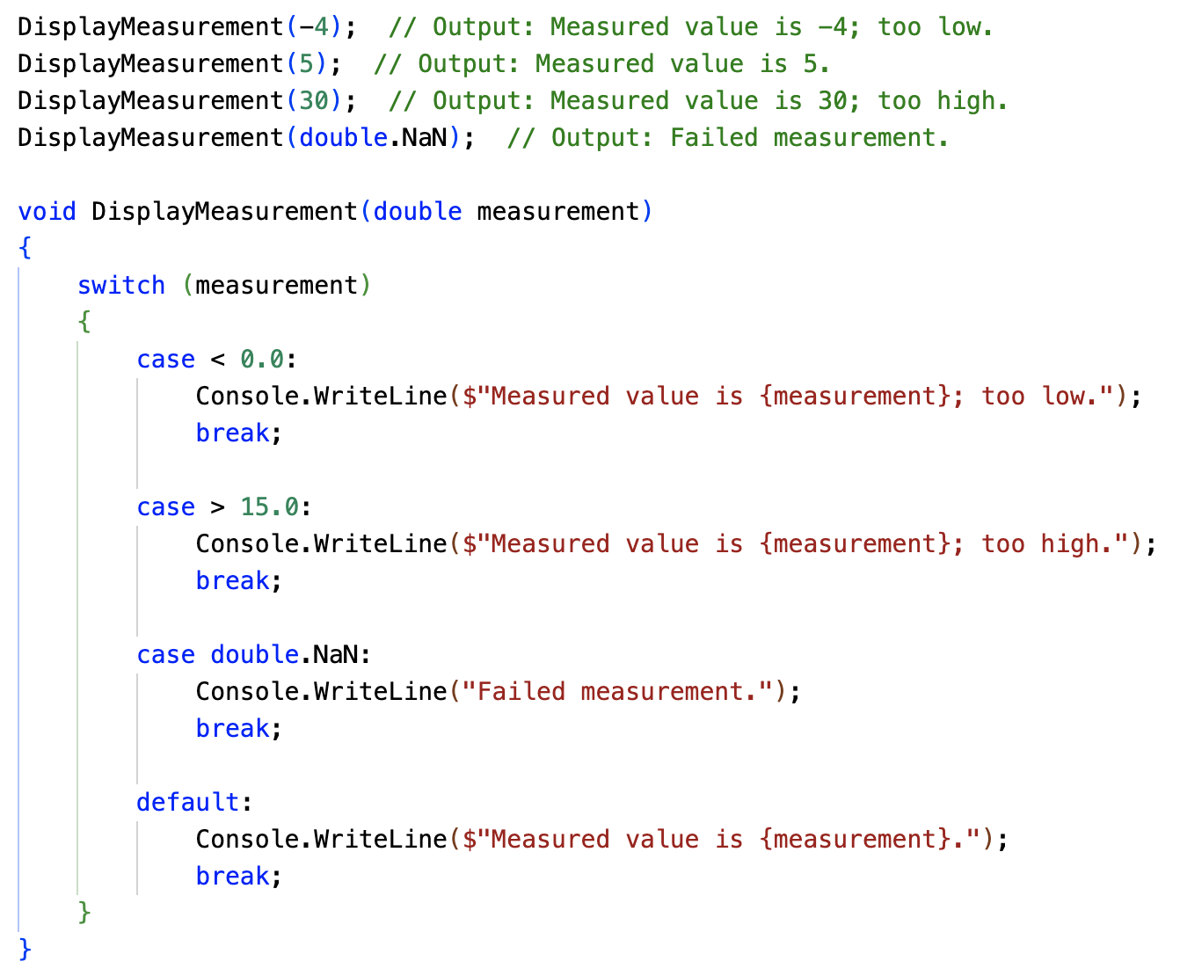
The switch statement
The switch statement selects a statement list to execute based on a pattern match with a match expression, as the following example shows:
References: https://learn.microsoft.com/en-us/dotnet/csharp/language-reference/statements/selection-statements

Slide 63

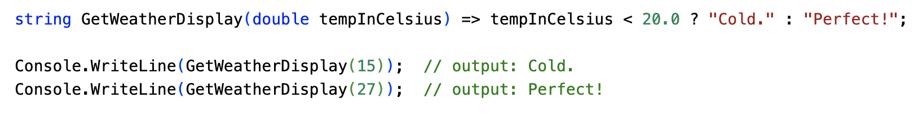
Conditional operator ?:
The conditional operator ?:, also known as the ternary conditional operator, evaluates a Boolean expression and returns the result of one of the two expressions, depending on whether the Boolean expression evaluates to true or false, as the following example shows:
References: https://learn.microsoft.com/en-us/dotnet/csharp/language-reference/operators/conditional-operator

Slide 64
2.4 Iteration statements
for, foreach, do, and while
References: https://learn.microsoft.com/en-us/dotnet/csharp/language-reference/statements/iteration-statements

Slide 65
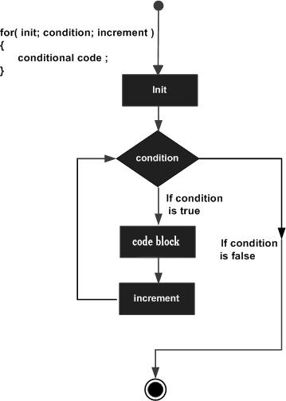
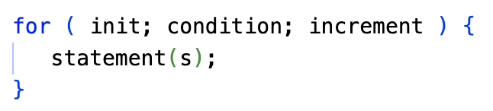
The for statement
A for loop is a repetition control structure that allows you to efficiently write a loop that needs to execute a specific number of times.
References: https://learn.microsoft.com/en-us/dotnet/csharp/language-reference/statements/iteration-statements

Slide 66
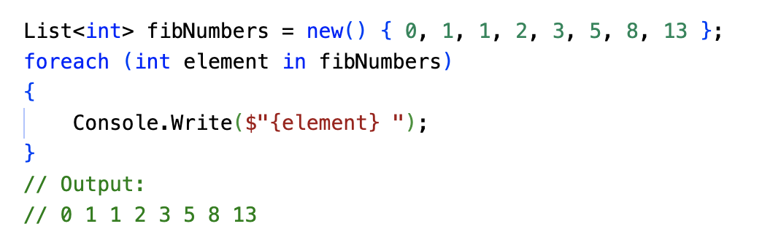
The foreach statement
The foreach statement executes a statement or a block of statements for each element in an instance of the type that implements the System.Collections.IEnumerable or System.Collections.Generic.IEnumerable<T> interface, as the following example shows:
References: https://learn.microsoft.com/en-us/dotnet/csharp/language-reference/statements/iteration-statements

Slide 67
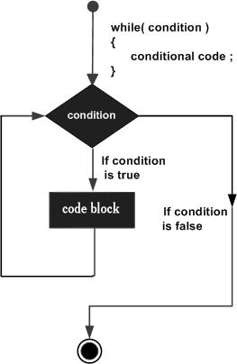
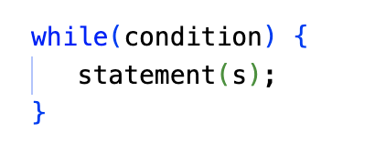
The while statement
A while loop statement in C# repeatedly executes a target statement as long as a given condition is true.
References: https://learn.microsoft.com/en-us/dotnet/csharp/language-reference/statements/iteration-statements

Slide 68
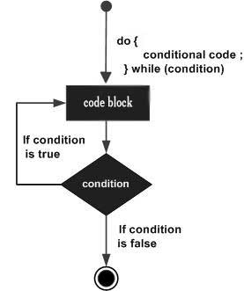
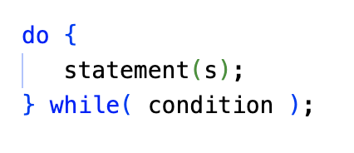
The do…while statement
Unlike for and while loops, which test the loop condition at the start of the loop, the do...while loop checks its condition at the end of the loop.
A do...while loop is similar to a while loop, except that a do...while loop is guaranteed to execute at least one time
References: https://learn.microsoft.com/en-us/dotnet/csharp/language-reference/statements/iteration-statements

Slide 69
Recap
C# as a Language
Compiled Language: Ensures efficient execution and optimization.
Managed Code: Benefits from automatic memory management.
Strongly Typed: Enforces type safety for reliable code.
Object-Oriented: Supports object-oriented principles for modular and reusable code.
Function-Based: Allows for modular and reusable code through functions.

Slide 70
Recap
Data Types in C#
Integer Types: int, long, short, byte, uint, ulong
Floating-Point Types: float, double
String: Represents text
Boolean: Represents true or false
DateTime: Represents date and time values
Struct: User-defined value type for simple data structures

Slide 71
Recap
Operators in C#
Arithmetic: +, -, *, /, %
Relational: ==, !=, <, >, <=, >=
Logical: &&, ||, !
Bitwise: &, |, ^, ~, <<, >>
Assignment: =
Other: +=, -=, *=, /=, %=, ++, --

Slide 72
Recap
Control Flow Statements
if/else: Conditional execution.
switch: Multiple-choice execution.
for: Loop for a specific number of iterations.
foreach: Loop over elements in a collection.
while: Loop while a condition is true.
do-while: Loop at least once and then while a condition is true.

Slide 73
Recap
Additional Topics:
Arrays: Collections of elements of the same data type.
Lists: Dynamically sized collections of elements.
Dictionaries: Key-value pairs for efficient data lookup.

